Slide 1

GraphQL Meetup Hamburg | June 2018 | @nilshartmann
NILS HARTMANN
Schema
Stitching
with Apollo GraphQL
Slides: https://bit.ly/nordic-coding-graphql

Slide 2
@nilshartmann
NILS HARTMANN
Software Developer from Hamburg
JavaScript, TypeScript, React
Java
Trainings, Workshops
nils@nilshartmann.net

Slide 3
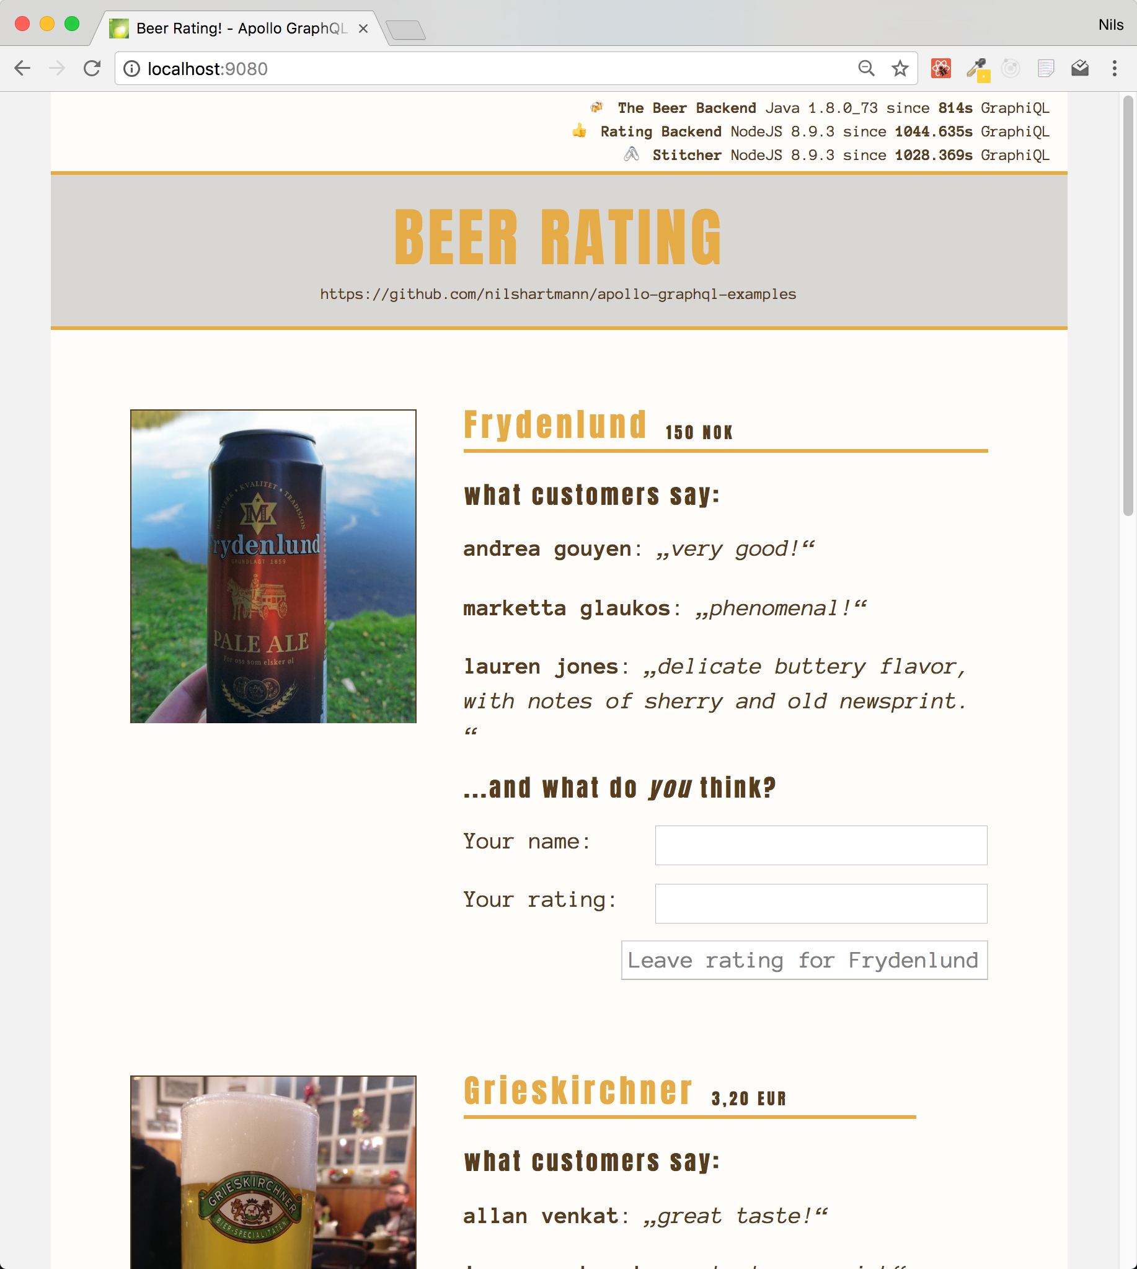
Source Code: https://bit.ly/graphql-stitching-example
Example

Slide 4
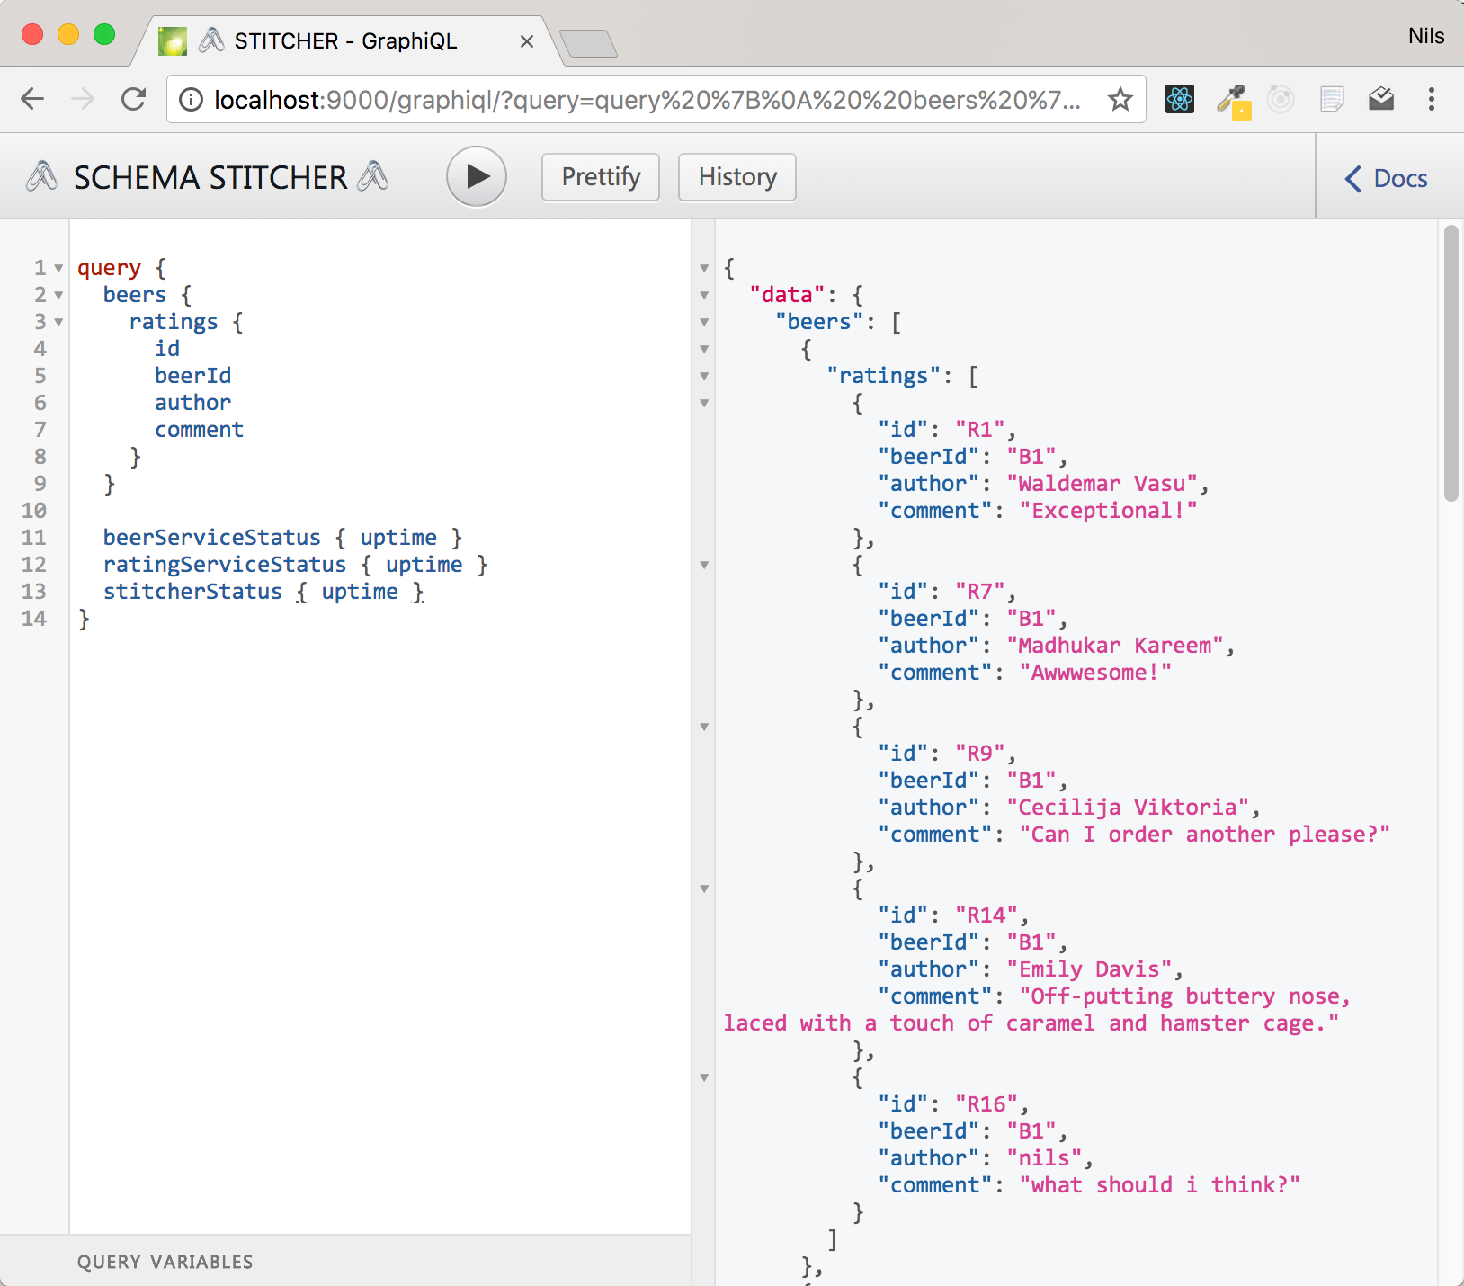
http://localhost:9000
Demo: GraphiQL

Slide 5
Apollo GraphQL
Apollo Server: https://www.apollographql.com/docs/apollo-server/
Open-Source-Framework for building GraphQL Server (JavaScript)
Exposes Types and Resolver (Schema) via HTTP endpoint

Slide 6
Apollo GraphQL
Example: A GraphQL Server with Apollo
// imports omitted
const schema = makeExecutableSchema({
typeDefs: `Query { hello { name: String } }`,
resolvers: {
Query: { hello: () => ({ name: "World" }) }
}
});
const app = express();
app.use("/graphql", bodyParser.json(), graphqlExpress({ schema }));
app.listen();

Slide 7
Overview
Tasks
Fetch the individual schemas from their remote endpoint
Rename the ProcessInfo type from each schema
Create the "link" between the two schemas
Add ratings field to Beer type
Merge schemas into one new Schema
Expose merged Schema via HTTP Endpoint

Slide 8
Apollo GraphQL
Step 1: Fetch the Remote Schemas
import fetch from "node-fetch";
import { introspectSchema, makeRemoteExecutableSchema } from "graphql-tools";
import { HttpLink } from "apollo-link-http";
async function createRemoteSchema(uri) {
// Configure network connection
const link = new HttpLink({ uri, fetch });
// Fetch the schema
const schema = await introspectSchema(link);
// create an "executable" schema
return makeRemoteExecutableSchema({
schema,
link
});
}
const beerSchema = await createRemoteSchema("localhost:9010/graphql");
const ratingSchema = await createRemoteSchema("localhost:9020/graphql");

Slide 9
Transforming Schemas
Step 2: Rename Types and Root-Fields
Type ProcessInfo to {System}Status

Slide 10
Transforming Schemas
Step 2: Rename Types and Root-Fields
Type ProcessInfo to {System}Status
Root-Field ping to {system}Status

Slide 11
Transforming Schemas
Step 2: Rename Types and Root-Fields
transformSchema expects a List of Transform operations
Returns new Schema instance
import { transformSchema } from "graphql-tools";
function renameInSchema(schema) {
return transformSchema(schema, [
]);
}

Slide 12
Transforming Schemas
Rename Type ProcessInfo to {System}Status
import { transformSchema, RenameTypes } from "graphql-tools";
function renameInSchema(schema, systemName) {
return transformSchema(schema, [
// 1. ProcessInfo => XyzStatus
new RenameTypes(
name => (name === "ProcessInfo" ? `${systemName}Status` : name
]);
}

Slide 13
Apollo GraphQL
Rename Root-Field ping to {system}Status
import { transformSchema, RenameTypes, RenameRootFields } from "graphql-tools";
function renameInSchema(schema, systemName) {
return transformSchema(schema, [
// 1. ProcessInfo => XyzProcessStatus
new RenameTypes(
name => (name === "ProcessInfo" ? `${systemName}Status` : name
),
// 2. ping => xyzStatus
new RenameRootFields(
(op, name) => name === "ping" ? : `${systemName}Status` : name
)
]);
}

Slide 14
Apollo GraphQL
Run the transformation in both Schemas
import { transformSchema, RenameTypes, RenameRootFields } from "graphql-tools";
function renameInSchema(schema, systemName) {
return transformSchema(schema, [
// 1.
new RenameTypes(
name => (name === "ProcessInfo" ? `${systemName}Status` : name
),
// 2.
new RenameRootFields(
(op, name) => name === "ping" ? : `${systemName}Status` : name
)
]);
}
const renamedBeerSchema = renameInSchema(beerSchema, "Beer");
const renamedRatingSchema = renameInSchema(ratingSchema, "Rating");

Slide 15
Link Schemas
Enhance existing schema
Add ratings to Beer Schema

Slide 16
Link Schemas
Enhance existing schema
Add ratings to Beer Schema
Delegate requests to ratings to Beer Endpoint

Slide 17
Link Schemas
Extend existing Type
Add ratings field to Beer Schema
function createLinkedSchema() {
return {
linkedTypeDefs: `
extend type Beer {
ratings: [Rating!]!
}
`
}
}

Slide 18
Link Schemas
Add Resolver
Namingconvention as in "regular" Apollo Resolvers
function createLinkedSchema(ratingSchema) {
return {
linkedTypeDefs: `extend type Beer {ratings: [Rating!]! }`,
linkedResolvers: {
Beer: {
ratings: {
}
}
}
}
}

Slide 19
Link Schemas
Add Resolver
Add Fragment to add fields needed for resolver from remote query
function createLinkedSchema(ratingSchema) {
return {
linkedTypeDefs: `extend type Beer {ratings: [Rating!]! }`,
linkedResolvers: {
Beer: {
ratings: {
fragment: `fragment BeerFragment on Beer { id }`,
}
}
}
}
}

Slide 20
Link Schemas
Add Resolver
Delegate execution to the other schema ("Rating" in our example)
function createLinkedSchema(ratingSchema) {
return {
linkedTypeDefs: `extend type Beer {ratings: [Rating!]! }`,
linkedResolvers: {
Beer: {
ratings: {
fragment: `fragment BeerFragment on Beer { id }`,
resolve: (parent, args, context, info) =>
info.mergeInfo.delegateToSchema({
schema: ratingSchema,
operation: "query",
fieldName: "ratingsForBeer",
args: { beerId: parent.id },
context, info
});
}
}
}
}
}

Slide 21
Link Schemas
Add Resolver
Delegate execution to the other schema ("Rating" in our example)
function createLinkedSchema(ratingSchema) {
return {
linkedTypeDefs: `extend type Beer {ratings: [Rating!]! }`,
linkedResolvers: {
Beer: {
ratings: {
fragment: `fragment BeerFragment on Beer { id }`,
resolve: (parent, args, context, info) =>
info.mergeInfo.delegateToSchema({
schema: ratingSchema,
operation: "query",
fieldName: "ratingsForBeer",
args: { beerId: parent.id },
context, info
});
}
}
}
}
}
Runs on Rating Schema:
query {
ratingsForBeer(beerId: ...) {
...
}
}

Slide 22
Merge Schemas
Step 4: Merge Schemas together
Create Remote Schemas (as seen before)
const beerSchema = await createRemoteSchema("localhost:9010/graphql");
const ratingSchema = await createRemoteSchema("localhost:9020/graphql");
const renamedBeerSchema = renameInSchema(beerSchema, "Beer");
const renamedRatingSchema = renameInSchema(ratingSchema, "Rating");

Slide 23
Merge Schemas
Step 4: Merge Schemas
Create the linked schema (as seen before)
const beerSchema = await createRemoteSchema("localhost:9010/graphql");
const ratingSchema = await createRemoteSchema("localhost:9020/graphql");
const renamedBeerSchema = renameInSchema(beerSchema, "Beer");
const renamedRatingSchema = renameInSchema(ratingSchema, "Rating");
const { linkedTypeDefs, linkedResolvers } = createLinkedSchema(renamedRatingSchema);

Slide 24
Merge Schemas
Step 4: Merge Schemas
Create merged schema with remote schema and linked schema
import { mergeSchemas } from "graphql-tools";
const beerSchema = await createRemoteSchema("localhost:9010/graphql");
const ratingSchema = await createRemoteSchema("localhost:9020/graphql");
const renamedBeerSchema = renameInSchema(beerSchema, "Beer");
const renamedRatingSchema = renameInSchema(ratingSchema, "Rating");
const { linkedTypeDefs, linkedResolvers } = createLinkedSchema(renamedRatingSchema);
const mergedSchema = mergeSchemas({
schemas: [
renamedBeerSchema,
renamedRatingSchema,
linkedTypeDefs
],
resolvers: linkedResolvers
});

Slide 25
Publish merged Schema
Step 5: Publishing
Expose Schema via HTTP endpoint using Express
import { graphqlExpress } from "apollo-server-express";
import express from "express";
import bodyParser from "body-parser";
// as seen before
const mergedSchema = mergeSchemas(. . .);
// create Express
const app = express();
// expose our schema
app.use("/graphql",
bodyParser.json(),
graphqlExpress({ schema: mergedSchema })
);
// run Express
app.listen(PORT);

Slide 26
@nilshartmann
🍻
Thank you!
Slides: https://bit.ly/nordic-coding-graphql
Sample-Code: https://bit.ly/graphql-stitching-example

